Slide 1



Slide 2
CLASSIFICATION
LINEAR DATA STRUCTURES
STACKS
QUEUES
LINKED LIST

Slide 3
STACKS
Stacks hold objects, usually of the same type.
It follows the concept of LIFO – last in first out.
Stack is a linear list of items in which all additions and deletion are restricted to one end.
In stack, insertion and deletion is possible on only one side of the stack. The other side is sealed.

Slide 4
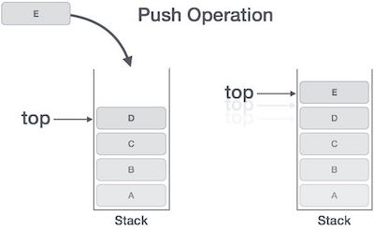
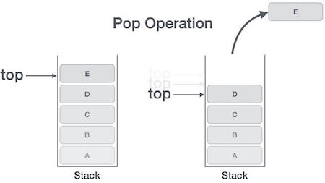
EXCEPTIONS:
Overflow exception: happens when there is no more room left to store a data item that is pushed
Underflow exception: happens when the stack is empty and the user executed a pop operation

Slide 5
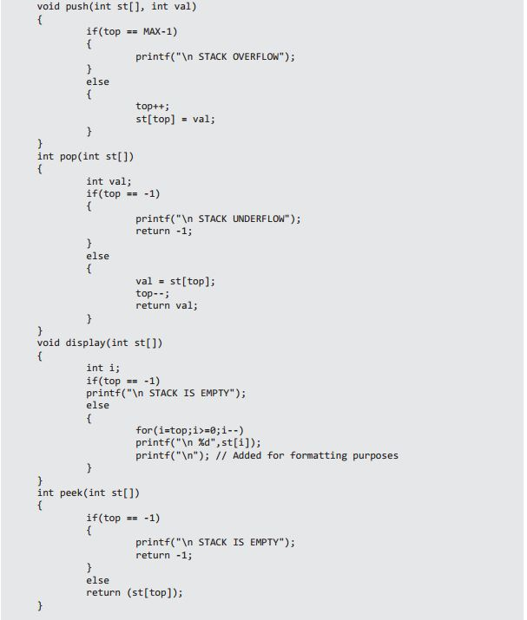

Slide 7
INFIX TO POSTFIX CONVERSION
If a token is an integer, write it into the output.
If a token is an operator, push it to the stack, if the stack is empty. If the stack is not empty, you pop entries with higher or equal priority and only then you push that token to the stack.
If a token is a left parentheses '(', push it to the stack
If a token is a right parentheses ')', you pop entries until you meet '('.
When you finish reading the string, you pop up all tokens which are left there.
Arithmetic precedence is in increasing order:
'+', '-', '*', '/'

Slide 8
Suppose we have an infix expression:2+(4+3*2+1)/3. We read the string by characters.
'2' - send to the output.
'+' - push on the stack.
'(' - push on the stack.
'4' - send to the output.
'+' - push on the stack.
'3' - send to the output.
'*' - push on the stack.
'2' - send to the output.

Slide 9
EVALUATING A POSTFIX EXPRESSION
We read the tokens in one at a time.
If it is an integer, push it on the stack
If it is a binary operator, pop the top two elements from the stack, apply the operator, and push the result back on the stack.
5 9 3 + 4 2 * * 7 + *
push(5);
push(9);
push(3);
push(pop() + pop())
push(4);
push(2);
push(pop() * pop()) push(pop() * pop())
push(7)
push(pop() + pop()) push(pop() * pop())

Slide 10
DRAWBACKS OF SEQUENTIAL MEMORY ALLOCATION
This method suffers from both internal and external fragmentation. This makes it inefficient in terms of memory utilization.
Increasing file size is difficult because it depends on the availability of contiguous memory at a particular instance.
Size of the file is to be declared in advance.

Slide 11
WHY LINKED LIST
This is very flexible in terms of file size. File size can be increased easily since the system does not have to look for a contiguous chunk of memory.
This method does not suffer from external fragmentation. This makes it relatively better in terms of memory utilization.

Slide 12

WHAT IS LINKED LIST
A Linked List is a linear collection of data elements called Nodes. Each node contains one or more data fields and a pointer to the next node
The left part of the node which contains data may include a simple data type, an array, or a structure.
The right part of the node contains a pointer to the next node (or address of the next node in sequence).
The last node will have no next node connected to it, so it will store a special value called NULL.
A Linked List also contains a pointer variable START which stores the starting address of the program.

Slide 13
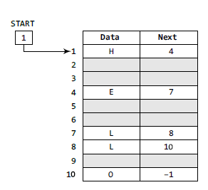
STRUCTURE OF LL
START stores the address of the first Node so the first data is stored at address 1 (H).
The corresponding next stores the address of the next node which is 4.
We will look at address 4 to fetch the data element (E).
The process is repeated until NULL is reached.

Slide 14
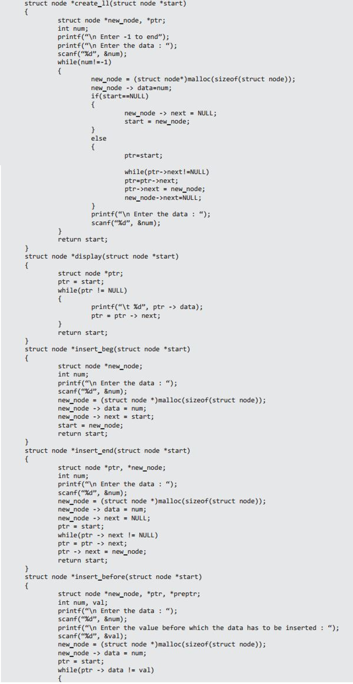
CREATING A LL

Slide 15
INSERT AT BEGINNING

Slide 16
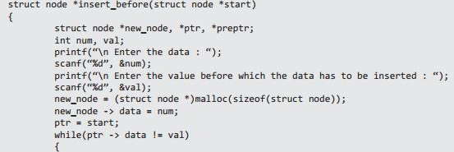
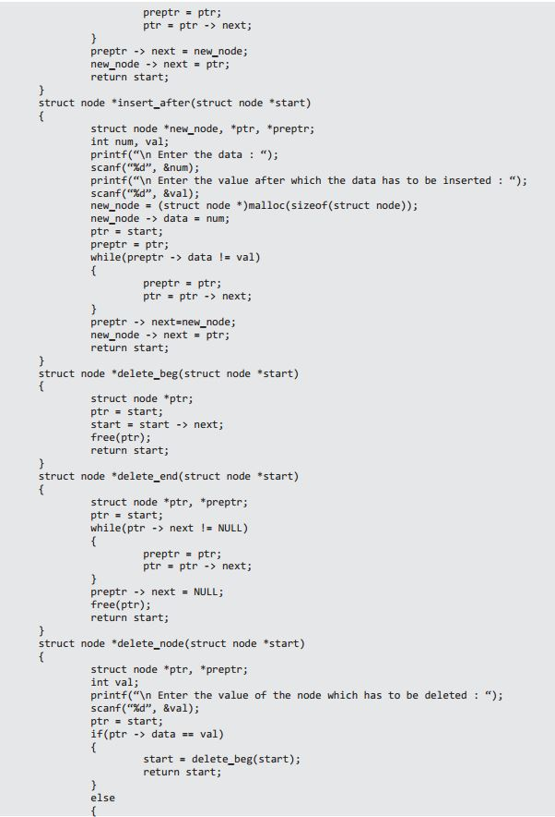
INSERT BEFORE ANY POSITION

Slide 17
INSERT AFTER ANY POSITION

Slide 18
INSERT AT END

Slide 19
DELETING NODES

Slide 20
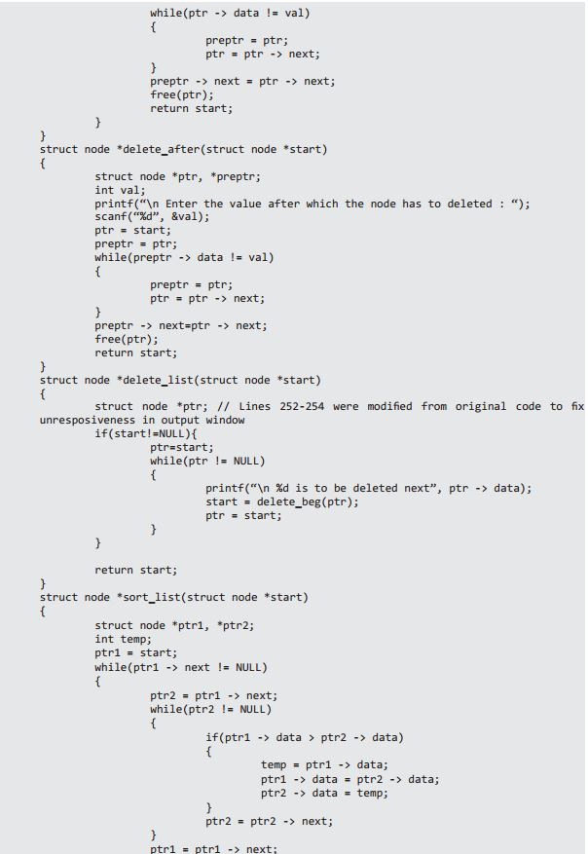
DELETING AFTER ANY POSITION

Slide 21


TYPES OF LINKED LIST
Circular Linked List
In a circular linked list the last node contains a pointer to the first node of the list. While traversing in a circular linked list we can begin at any node and traverse in any direction until we reach the node from where we started.
Doubly Linked List
A doubly linked list is a two way linked list. This means that it contains 2 pointers NEXT and PREV. Hence a doubly linked list consists of 3 parts data, pointer to the next node and a pointer to the previous node

